Slide 1
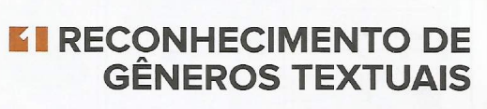
1- Recognition of Textual Genres

Slide 2
A- Cinnamon Apple Muffins
1 ½ cups flour
¾ cup sugar
1 ½ t. baking powder
1 t. cinnamon
½ cup milk
1/3 cup butter, melted
1 egg, slightly beaten
1 cup finely chopped apples
Heat oven to 375°F
Combine flour, sugar, baking powder and cinnamon in mediun bowl. Add all remaining ingredients. Stir just until flour is moistened. Spoon batter into muffin liners.
Bake 18-23 minutes. Let stand 5 minutes.

Slide 3
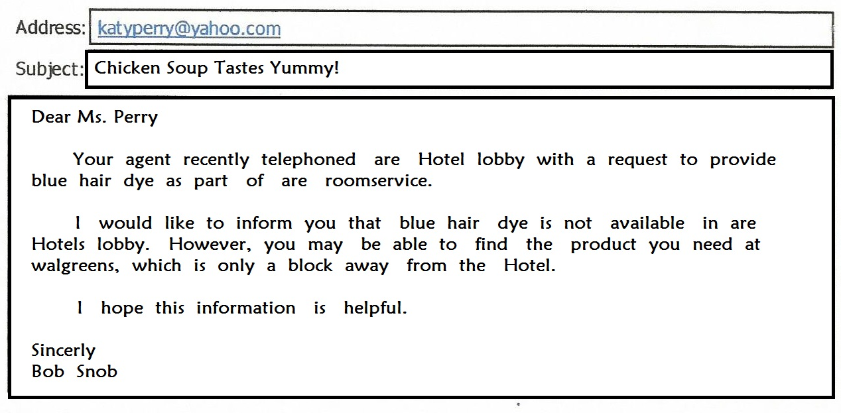
B

Slide 4
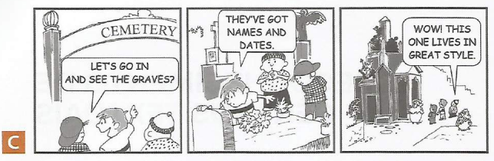

Slide 5
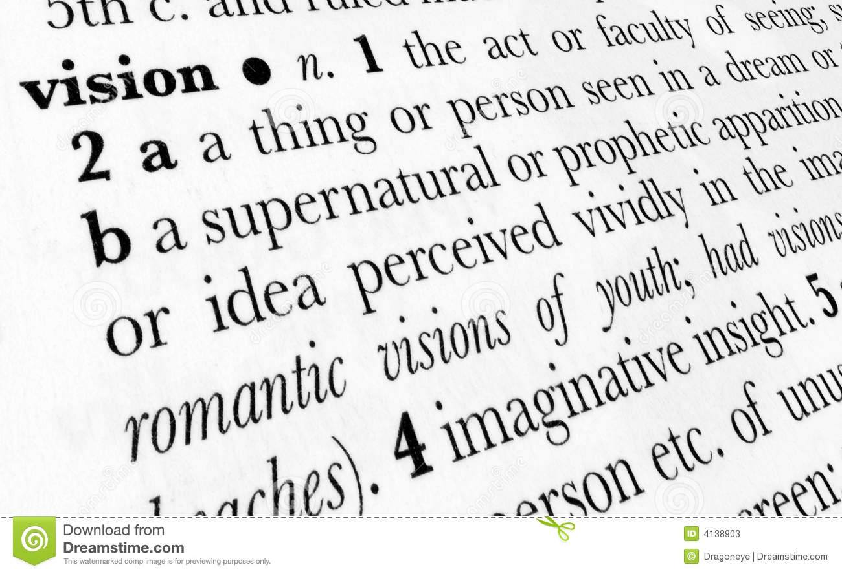
D

Slide 6
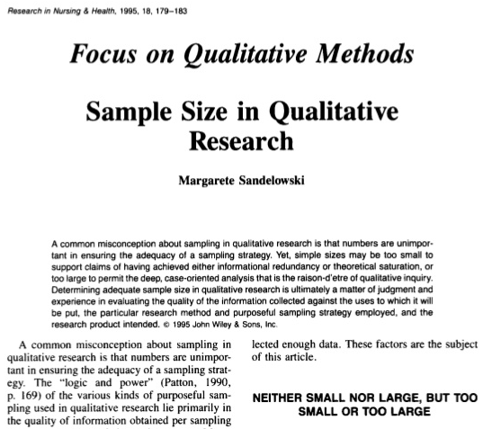
E

Slide 7
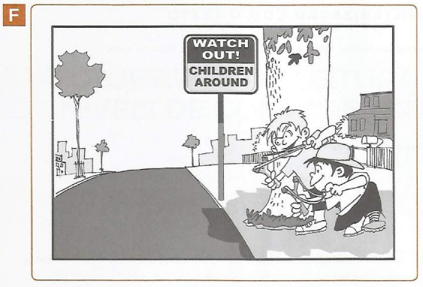

Slide 8

G
POST GRADE
Young Ryden Malby has just graduated from university and has a plan for the future: getting a good job, liking her best friend and finding the perfect match. However, the girl's plan goes downhill when she is forced to move in with her parents. She starts looking for the job of dreams and slowly realizes that nothing is significant without the people she loves.
Release Date: August 13, 2009 (Hollywood)
Cast: Alexis Biedel, zack Gilford, Michael Keaton, Carol Bumet, Rodrigo Santoro, Jane Lynch.
Directed by: Vicky Jenson
Music composed by: Christophe Beck
Genre: Comedy

Slide 9
Familiarization with context
Familiarização com o contexto
1- Observe the above cutouts and identify the different types of texts.
Observe os recortes acima e identifique os diferentes tipos de textos.
_________________________________________________________________________________________________________________________________________________________________________________________________________________________________________________________________________________________________________________________________________________________________________________________________________________________________________________________________________________________________________________________________________________________________________________________________________________________________________________________________________________________________________________________________________________________________

Slide 10
2- What allows us to identify them?
O que nos permite identificá-los?
( ) The layout. O formato.
( ) The typographic resources (bold, italics, etc.). Os recursos tipográficos (negritos, itálicos, etc.).
( ) The characteristic words of each type of text. As características das palavras de cada tipo de texto.
( ) The font. A fonte.
( ) figures. Figuras.

Slide 11
3- Based on the different texts, list what you expect to find in each of them.
Com base nos diferentes textos, liste o que você espera encontrar em cada um deles.
Observe the example below: Observe o exemplo abaixo:
A- lista de ingredientes e modo de fazer.
B- ________________________________
C- ________________________________
D- ________________________________
E- _________________________________
F- _________________________________
G- _________________________________

Slide 12
Strategy presentation
Apresentação de estratégia
Recognizing textual genres
Reconhecimento de gêneros textuais
Textual genres are types of texts whose communicative function is socially and culturally recognized by a particular community. In addition to having this specific communicative function, textual genres are characterized by organization, grammatical structure and specific vocabularies - as well as by the social context in which they occur.
Gêneros textuais são tipos de textos cuja função comunicativa é reconhecida social e culturalmente por uma determinada comunidade. Além de terem essa função comunicativa específica, os gêneros textuais se caracterizam por organização, estrutura gramatical e vocabulários específicos - assim pelo contexto social em que ocorrem.

Slide 13
Recognizing the genre of a text means having knowledge of its layout, that is, of the characteristics proper to them, which distinguish it from other genres. For example, the textual genre culinary recipe contains a list of ingredients and how to do it. The genre abstract of the scientific journal article in general presents the objective (s) of the research, the methodology, the results achieved and the conclusion. Familiarity with the textual genre enables the reader to perform more efficient readings, as it enables the reader to locate information more quickly.
Reconhecer o gênero de um texto significa ter conhecimento de seu formato, isto é, das características próprias a eles, as quais o distinguem de outros gêneros. Por exemplo, o gênero textual receita culinária contém uma lista de ingredientes e o modo de fazer. Já o gênero resumo de artigo de revista científica em geral apresenta o(s) objetivo(s) da pesquisa, a metodologia, os resultados alcançados e a conclusão. A familiaridade com o gênero textual possibilita ao leitor efetuar leituras mais eficientes, pois permite localizar informações mais rapidamente.

